Slide 1
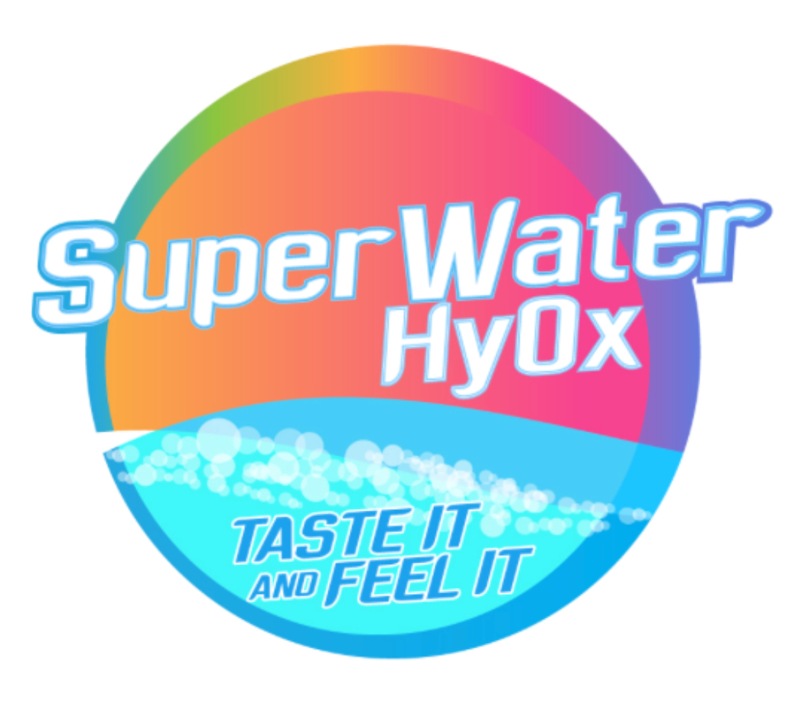

Slide 2
A new class of water for optimal body hydration.
Be smart ! Get the Best !!

Slide 3
PRODUCT BACKGROUND.
Unique dual Enhanced new water type.
Proprietary patent pending technology.
Increase dissolved oxygen content.
Hydrogen enriched process.
Naturally alkaline water.
better Antioxidant properties.
Medical doctor designed.

Slide 4
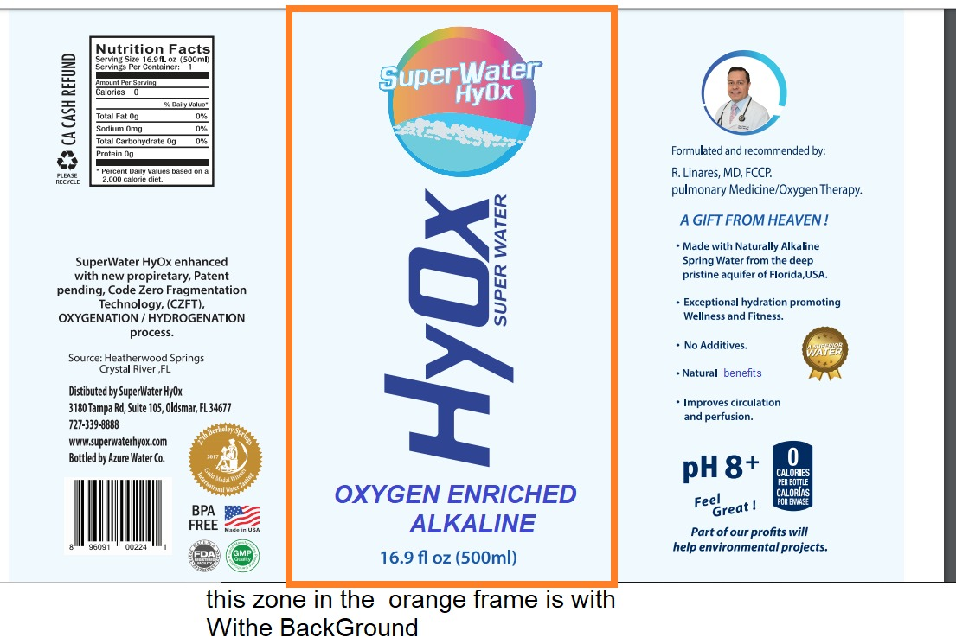

Slide 5
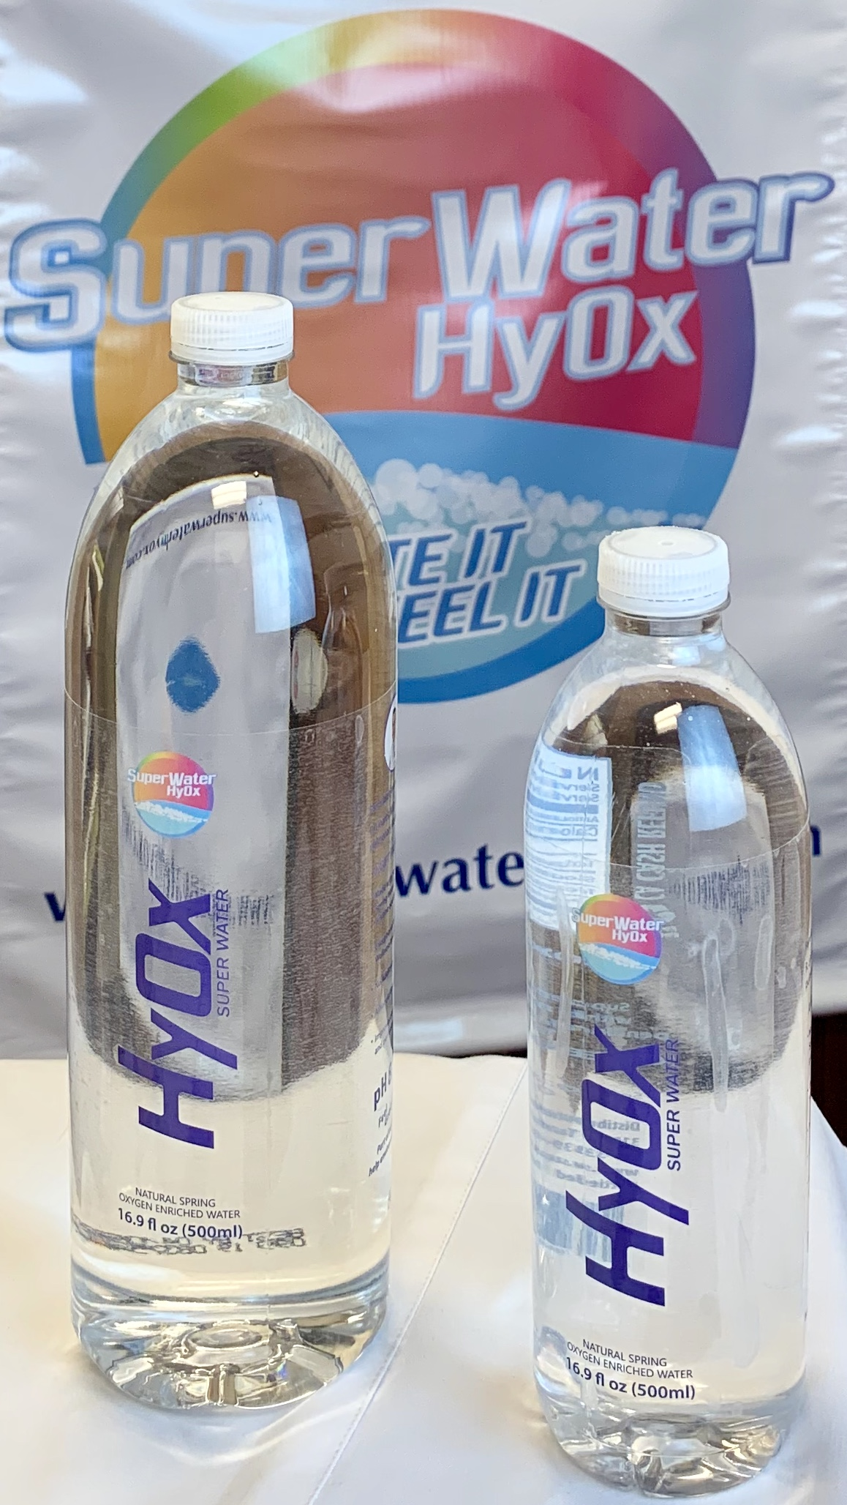
Presented in bottles of 500 mls =16 Oz and
1 Liter bottles = 32 Oz

Slide 6
Oxygen enriched water
Superior hydration than regular water or alkaline water.
Modern bottling plant with multiple purification and filtering systems.
Fda certified plant with good manufacturing practices.
Naturally occurring alkaline spring water with healthy Ph.
Electrolyte balanced.
Improves oxygen circulation.
Metabolic Oxy-redux antioxidant.

Slide 7
What is Superwater HyOX
The best way to keep prime health ,well being for your whole systems.
Healthy skin
Kidney perfusion
Adequate cardiac circulating volume.
Optimal secretions
Decrease anaerobic metabolism
Oxygenate detoxifying pathways

Slide 8
We are different
Hyox superwater is designed with an unique process for making the water to release its own oxygen and hydrogen molecules to stay dissolved for prolonged times as single elements improving the bioavailability of this elements for our normal biological processes.
Dissolved oxygen improved ,higher than regular drinking water, even after opening the containers.
Cooler at ambient temperatures.

Slide 9
Healthy
Oxygen is transported from stomach and gut directly into the blood plasma.
Plasma oxygenates and nourishes your tissues
Improves endurance by volume and oxygen delivery.
Oxygen Decreases lactic acid formation.
Non bloating.
Alkalinization reduces stomach acidity.

Slide 10
Before and after circulatory effects when drinking hyox superwater

Slide 11
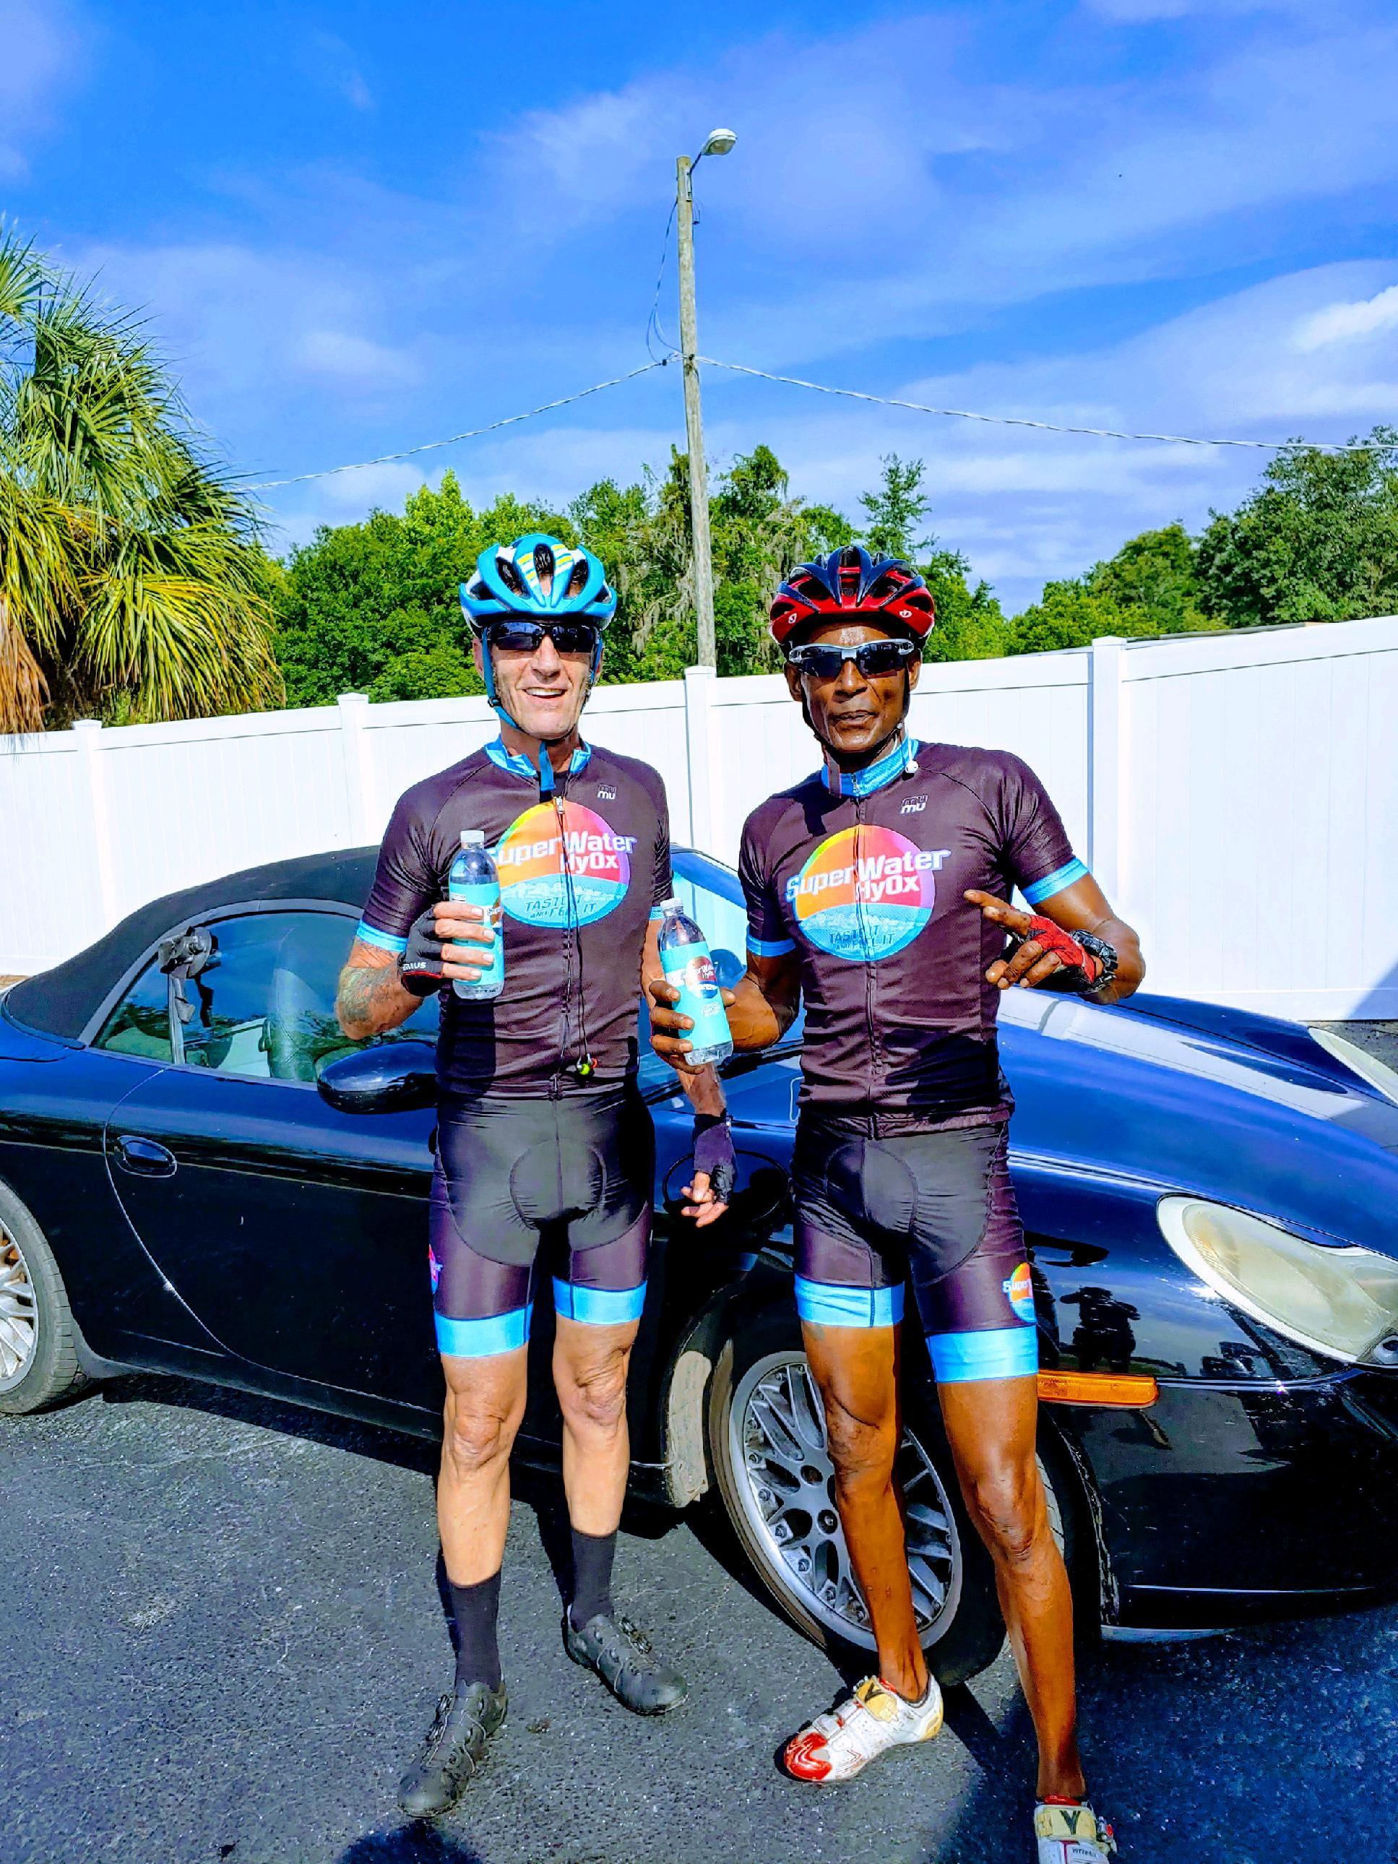

Slide 12
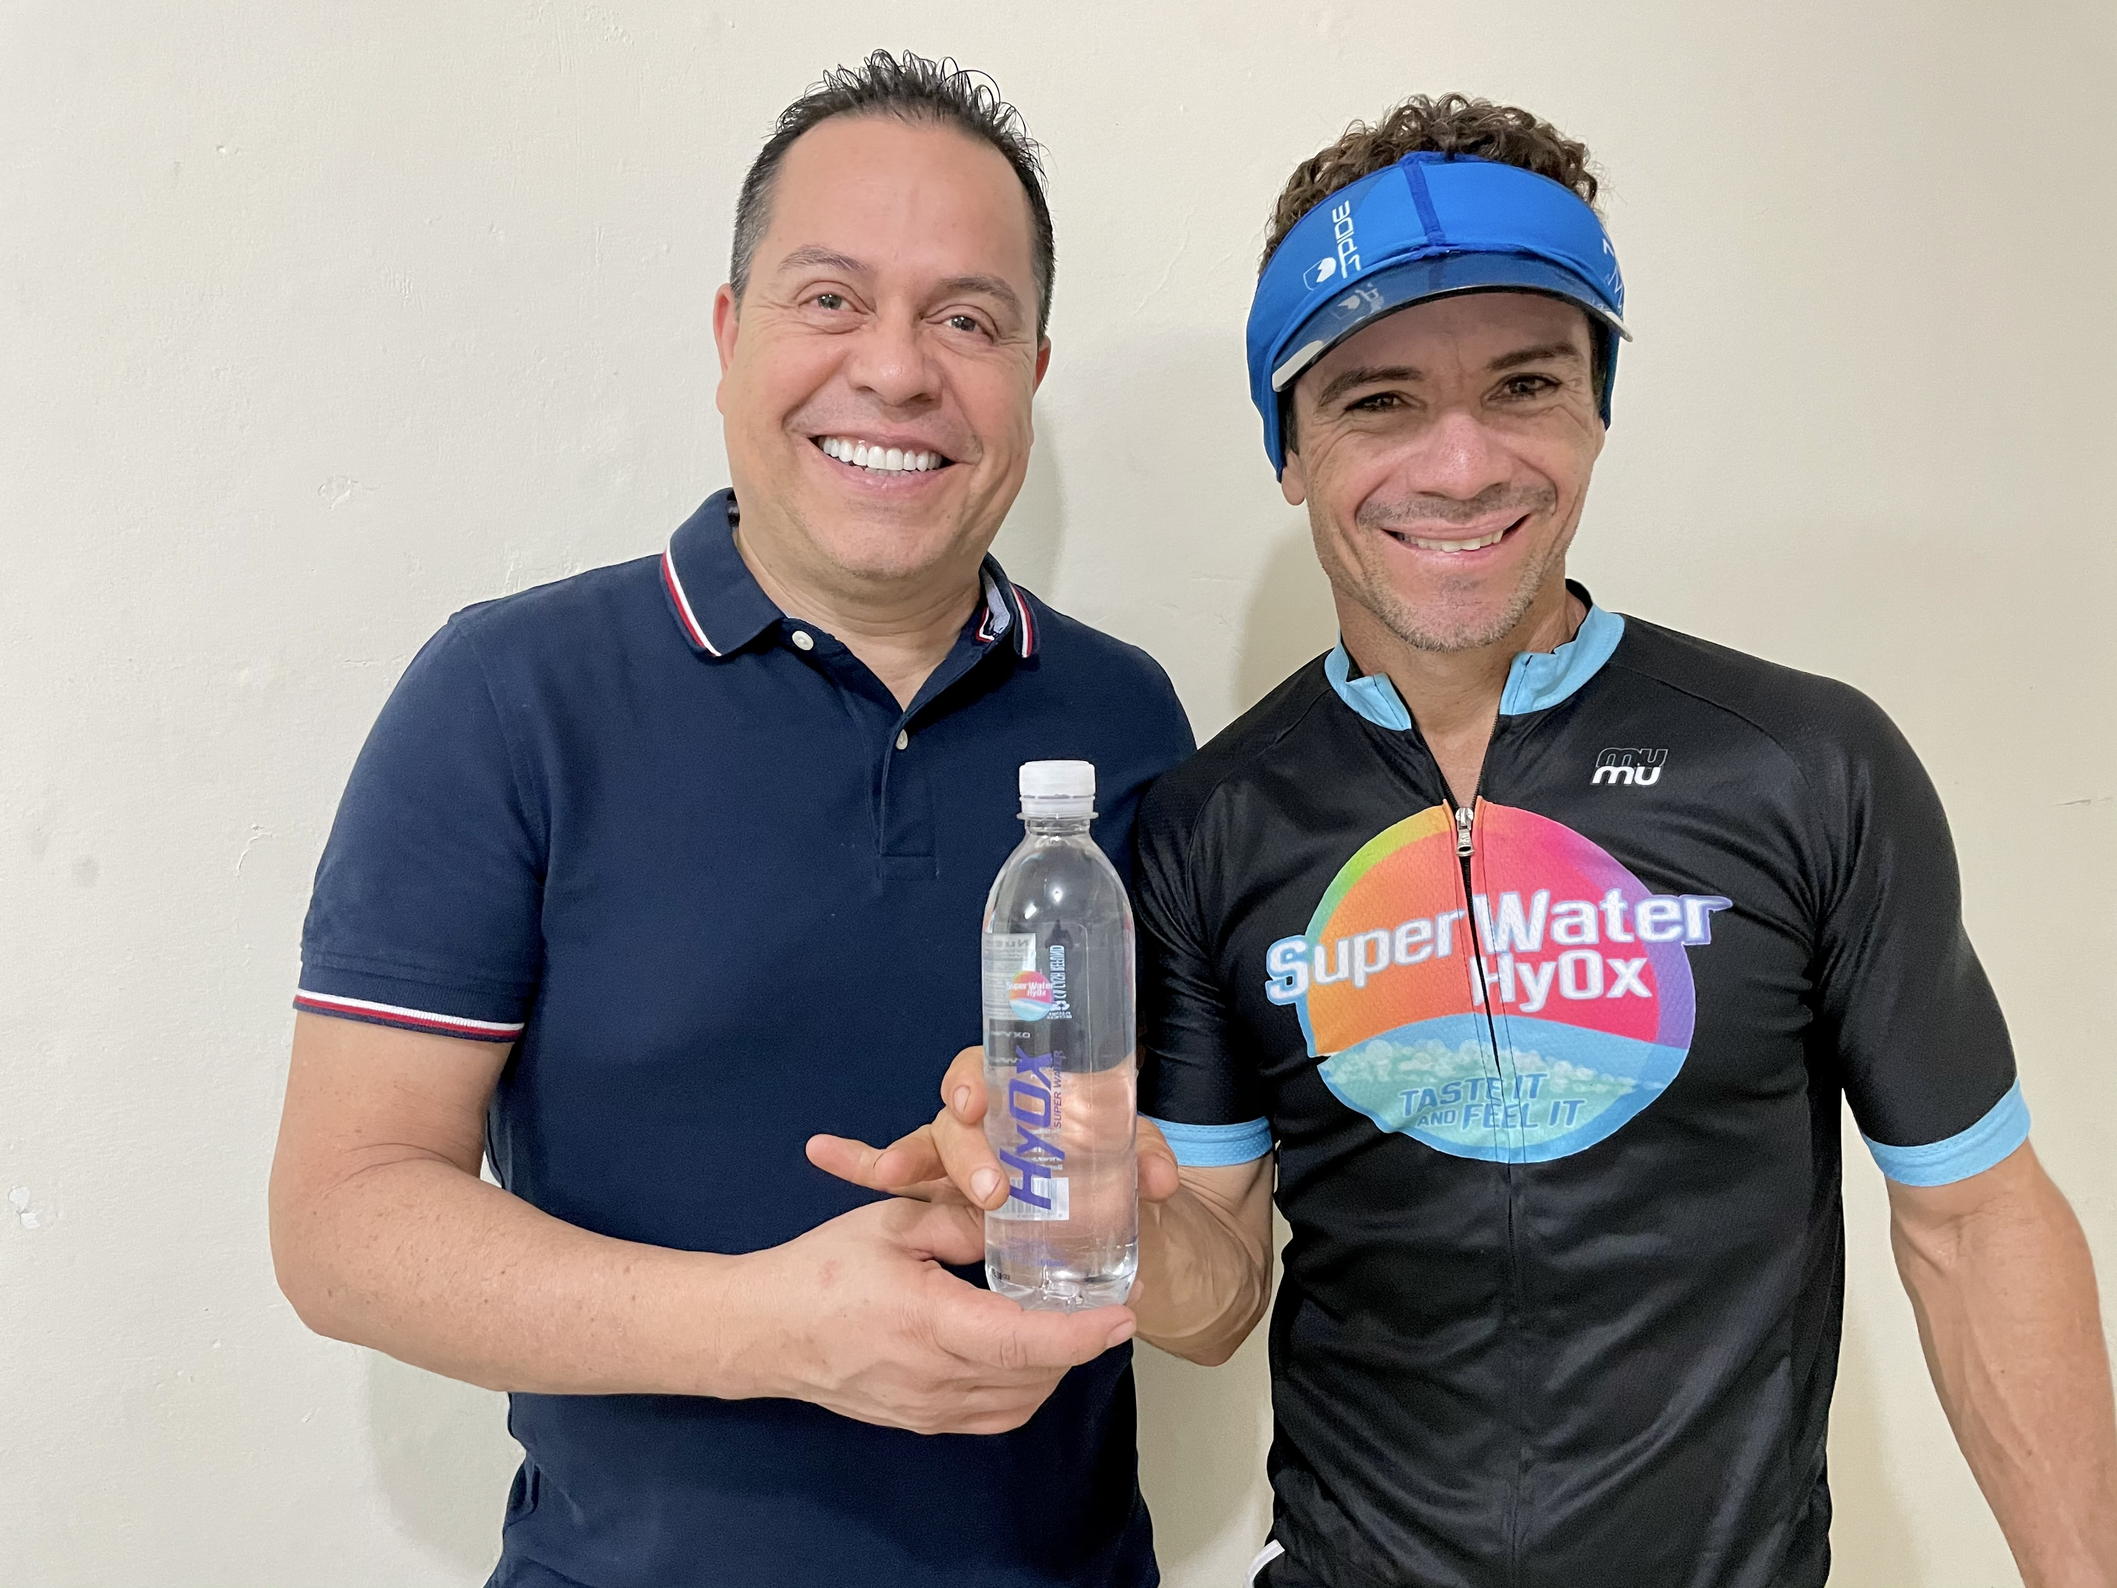
Camilo, Guinness world record holder in Spinning bike.

Slide 13
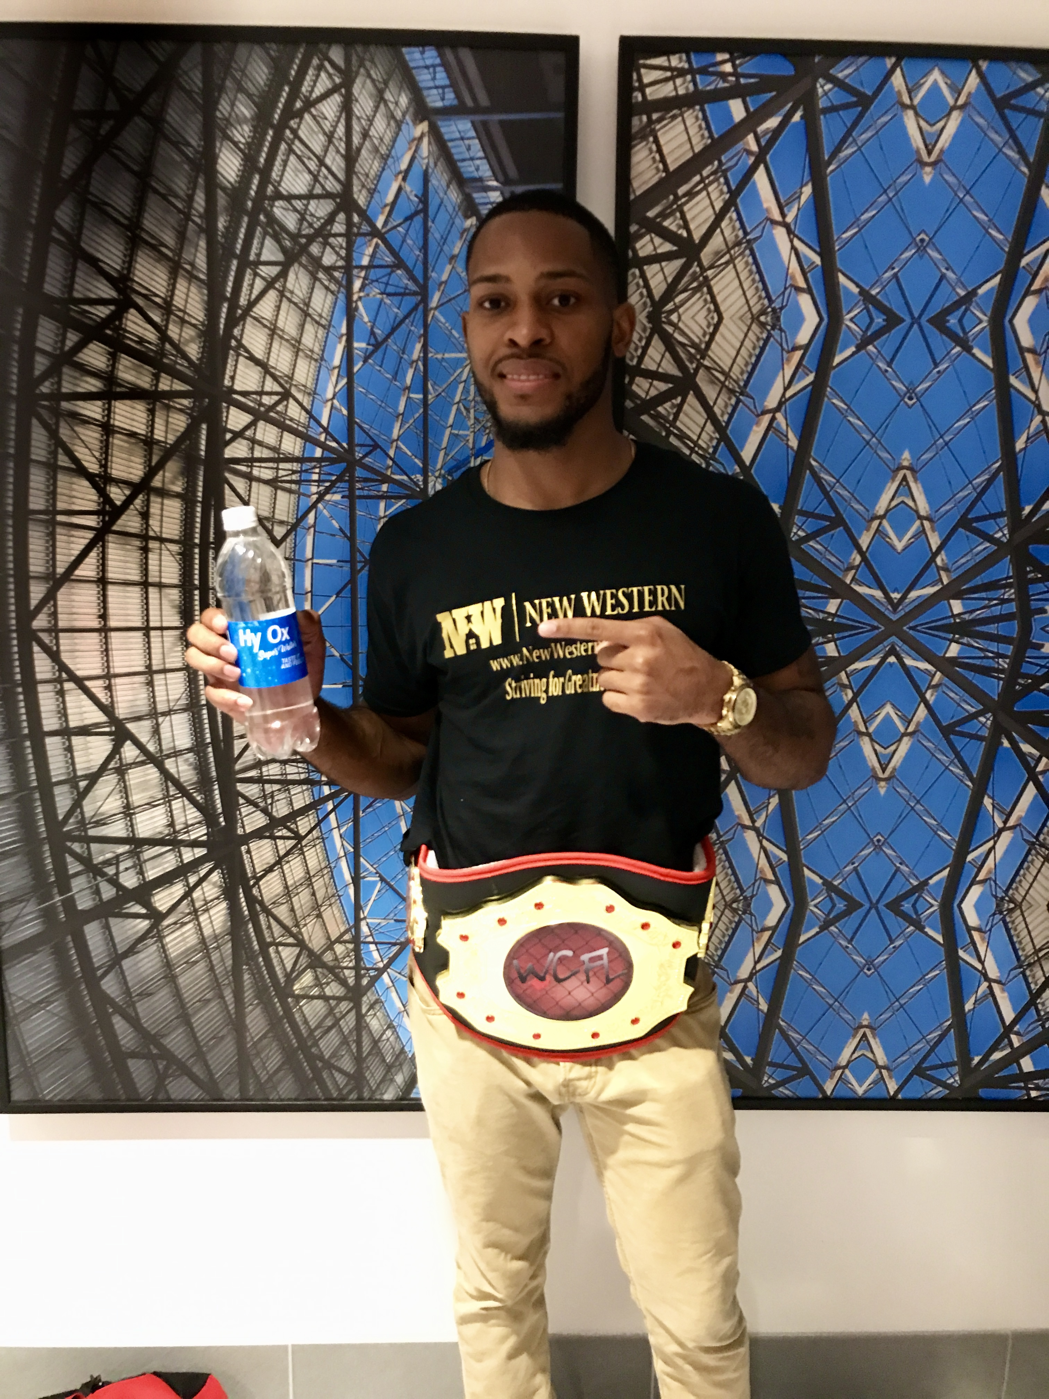

Slide 14
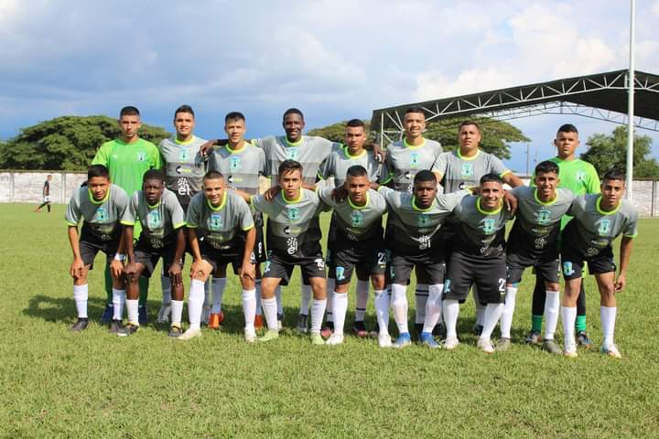
Soccer Team, Cali, Colombia.

Slide 15
- HYOX SUPERWATER : TEL : 714-317-0369
- EMAIL: MWCARVALHO60@GMAIL.COM

